Slide 1
AIR QUALITY INDEX MONITORING
-USING THINGSPEAK
VS RAKESH-210701205
JINESH K-210701508

Slide 2
INTRODUCTION
The project is an IoT-based air quality monitoring system using a NodeMCU (ESP8266) microcontroller, a DHT11 sensor, and an MQ135 gas sensor. This system measures temperature, humidity, and air quality, and uploads the data to the ThingSpeak platform for real-time monitoring and analysis. The DHT11 sensor provides temperature and humidity readings, while the MQ135 sensor detects harmful gases in the environment. Additionally, a buzzer is incorporated to alert users when gas levels exceed a predefined threshold, enhancing safety by providing immediate warnings of poor air quality. This project is ideal for environments requiring constant air quality monitoring, such as homes, offices, or industrial settings.

Slide 3
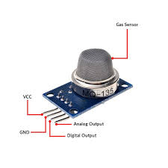
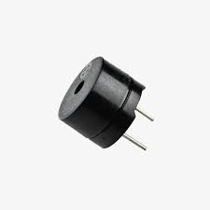
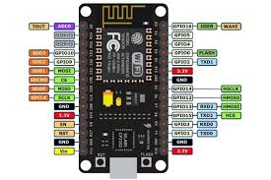
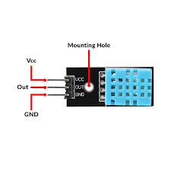
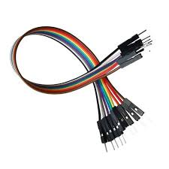
COMPONENTS USED
MQ-135
BUZZER
ESP-8266
DHT-11
JUMPER WIRES

Slide 4
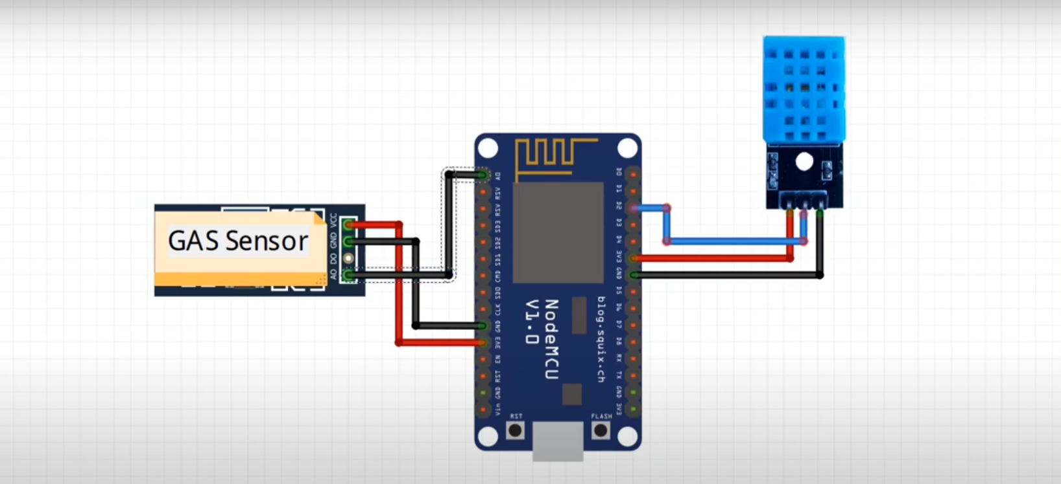
CIRCUIT DIAGRAM

Slide 5
THINGSPEAK SOFTWARE
ThingSpeak is an IoT analytics platform service that allows users to aggregate, visualize, and analyze live data streams in the cloud. By collecting data from sensors and devices over the internet, ThingSpeak enables real-time data analysis and visualization through easy-to-use charts and widgets. It supports various IoT protocols, making it a versatile tool for developers and engineers. Additionally, ThingSpeak offers MATLAB integration for advanced data analysis and predictive modeling. This platform is widely used for monitoring environmental data, building IoT projects, and creating smart applications that require remote data access and insights.

Slide 6
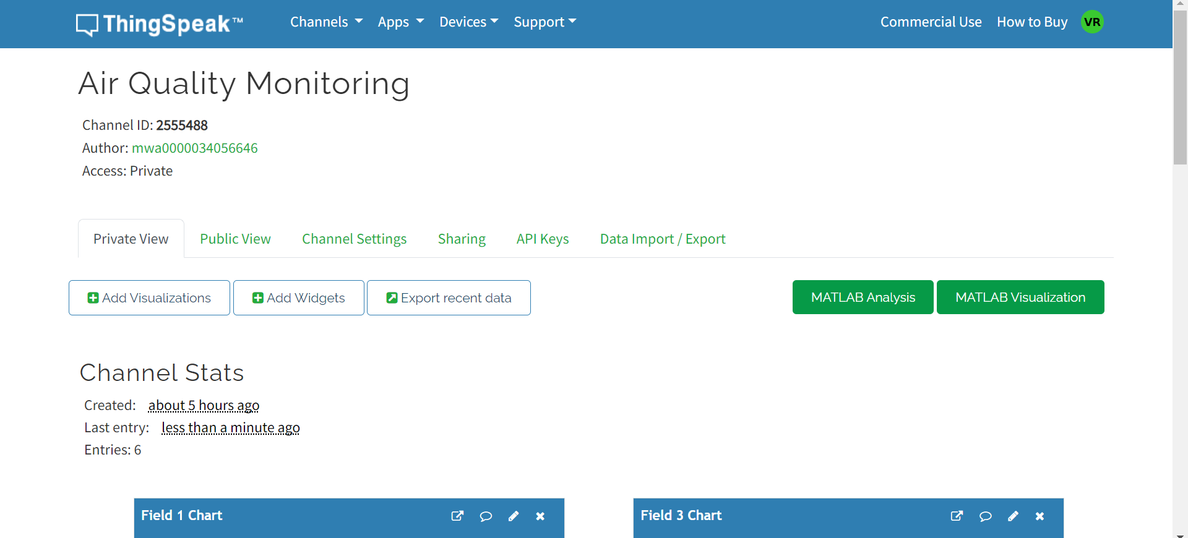
SOFTWARE INTERFACE

Slide 7
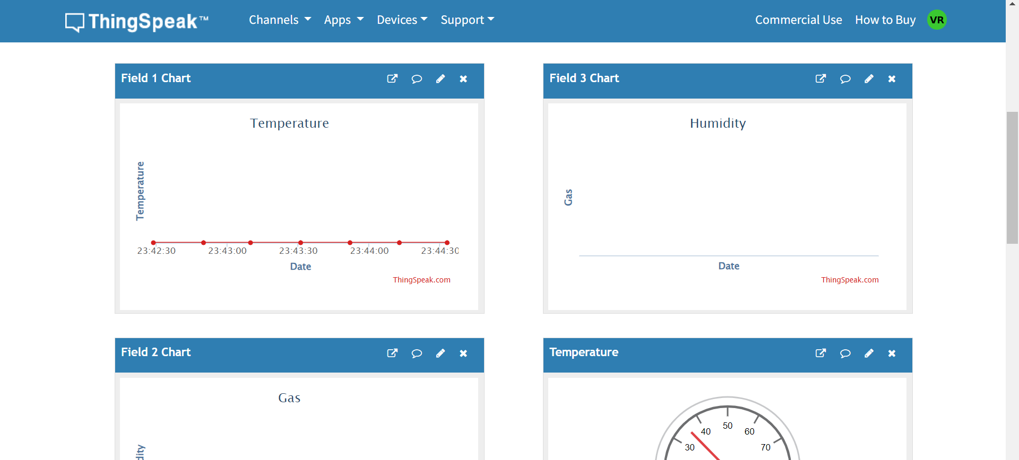
SOFTWARE FUNCTIONALITIES

Slide 8
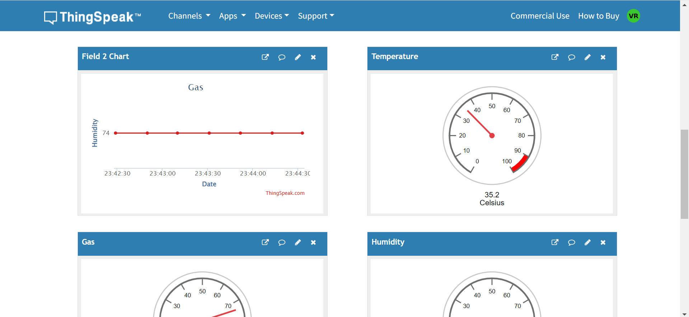
SOFTWARE FUNCTIONALITIES

Slide 9
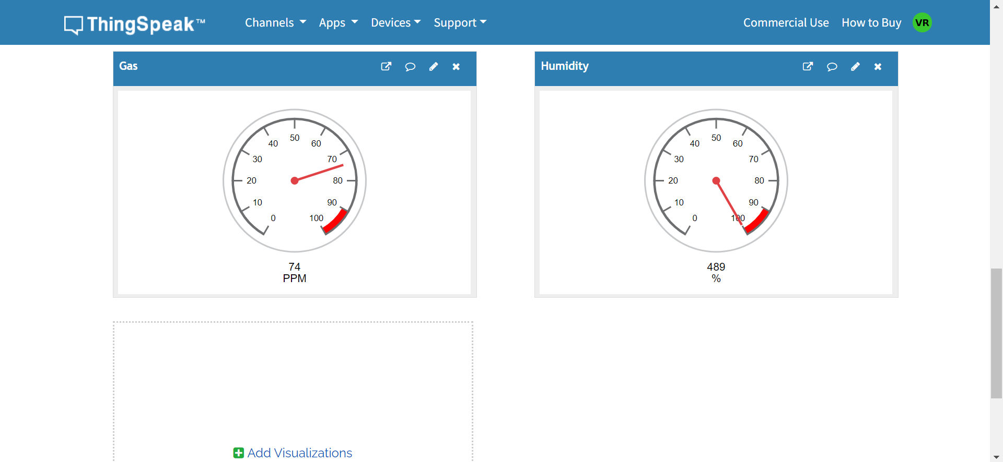
SOFTWARE FUNCTIONALITIES

Slide 10
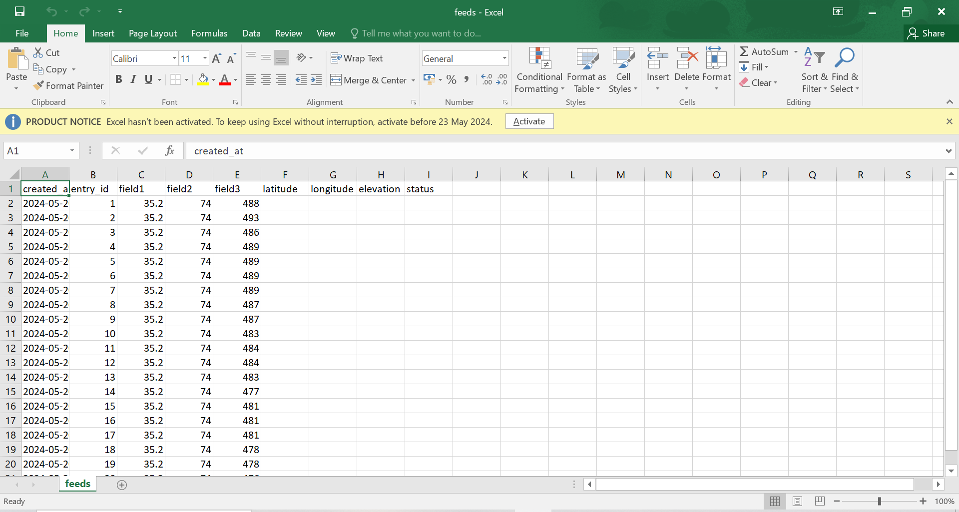
DATA COLLECTION

Slide 11
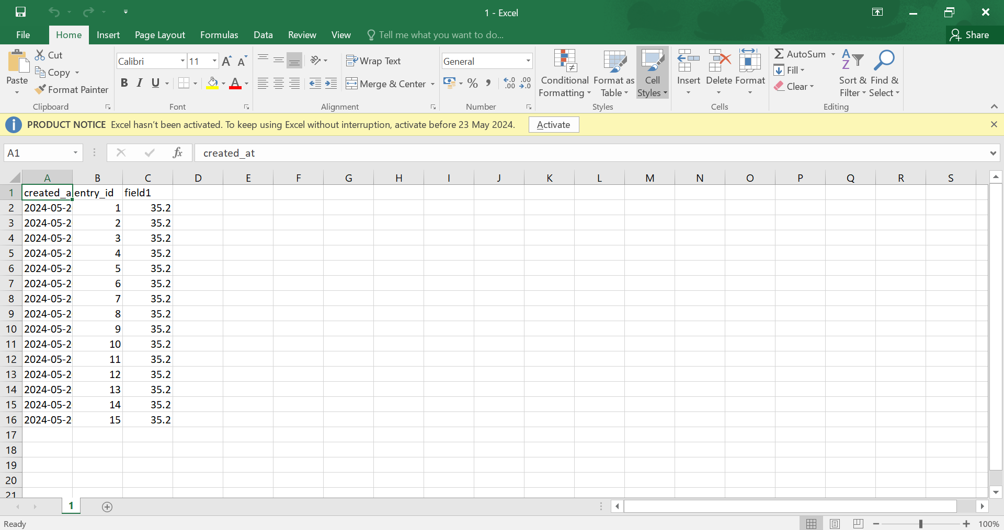
DATA COLLECTION

Slide 12
ADVANTAGES
The IoT-based air quality monitoring system offers several significant advantages. It provides continuous, real-time data on air quality, temperature, and humidity, ensuring immediate awareness of environmental conditions. By uploading data to ThingSpeak, users can remotely access and monitor air quality from anywhere with internet connectivity. The system includes a buzzer that emits immediate alerts when harmful gas levels exceed a predefined threshold, enhancing safety. Additionally, ThingSpeak enables historical data storage and visualization, allowing for trend analysis and better understanding of environmental patterns. This cost-effective solution utilizes affordable components like the NodeMCU, DHT11, and MQ135 sensors, making it suitable for various environments, including homes, offices, and industrial settings, to ensure a healthy and safe atmosphere. Its simple setup and programming make it accessible for both hobbyists and professionals.

Slide 13
CONCLUSION
In conclusion, the IoT-based air quality monitoring system effectively combines affordability, functionality, and accessibility to provide a comprehensive solution for monitoring environmental conditions. Utilizing the NodeMCU, DHT11, and MQ135 sensors, this project ensures real-time data collection and analysis of temperature, humidity, and air quality. The integration with ThingSpeak allows for remote monitoring and detailed trend analysis, while the buzzer provides immediate alerts for hazardous gas levels, enhancing safety. This system is ideal for diverse applications, from homes and offices to industrial environments, helping maintain a healthy and safe atmosphere. Its ease of implementation makes it a valuable tool for both hobbyists and professionals seeking to leverage IoT technology for environmental monitoring.

Slide 14
FUTURE ENHANCEMENT
Future enhancements for the IoT-based air quality monitoring system could significantly broaden its capabilities and user experience. Adding more sensors to measure pollutants like PM2.5, CO2, and VOCs would provide a more comprehensive assessment of air quality. Developing a mobile app for real-time data access and alerts on smartphones would enhance user convenience. Integrating machine learning could enable predictive analysis and proactive alerts. Automating responses, such as activating air purifiers based on air quality readings, would further improve safety. Additionally, implementing battery power with solar charging for portability, incorporating geolocation for mapping pollution levels, and enhancing data visualization and multi-user support would make the system more versatile and user-friendly. Improved alert mechanisms, including SMS and smart home assistant notifications, would ensure timely warnings and integration with broader IoT ecosystems.

